Slide 1
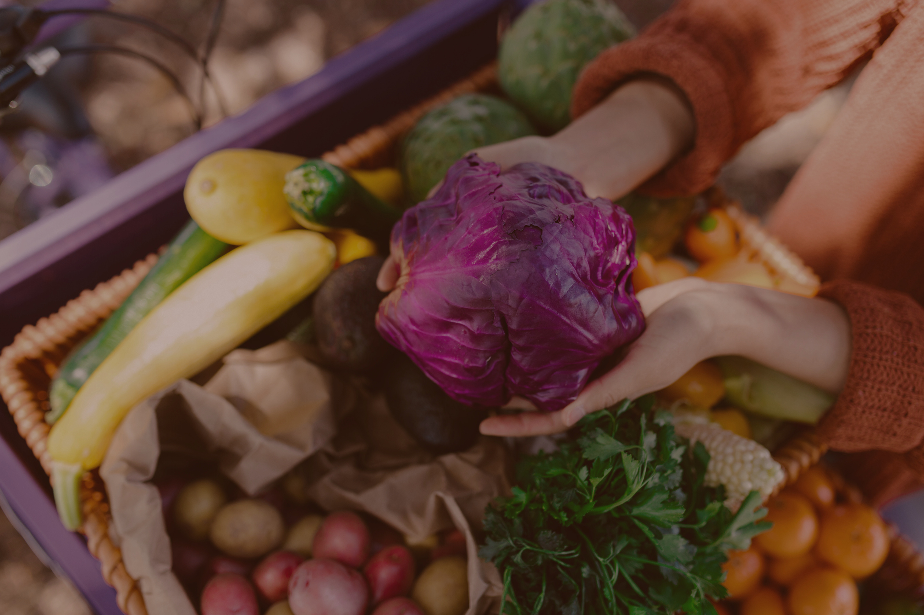
City of Jacksonville
STATE OF THE FOOD
An analysis of Jacksonville’s
Food System

Slide 2
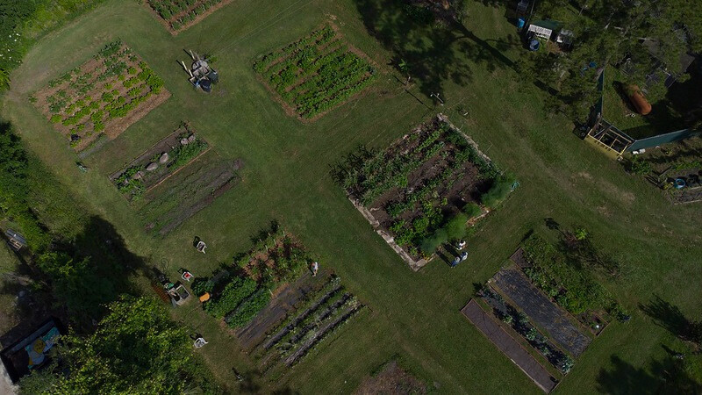
JAX FOOD
аbout
Jacksonville is a growing city with a growing demand for food.
Over the years we have experienced external shocks & stressors that have shaped the way people interact with food. Whether that be due to local agricultural barriers, limited distribution partnerships, shortages on supplemental government assistance & grocery stores, or the lack of food waste diversion programs, our food system is stable but needs additional support.
Notes:
- Population of JAX maybe
- How large-scale scale a city
- Maybe background before what we are today

Slide 3
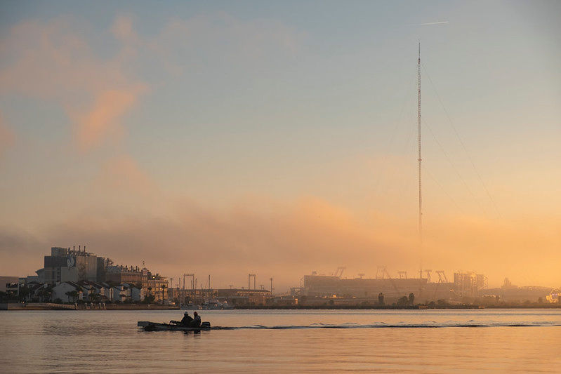
“Food is our common ground, a universal experience."
JAMES BEARD

Slide 4
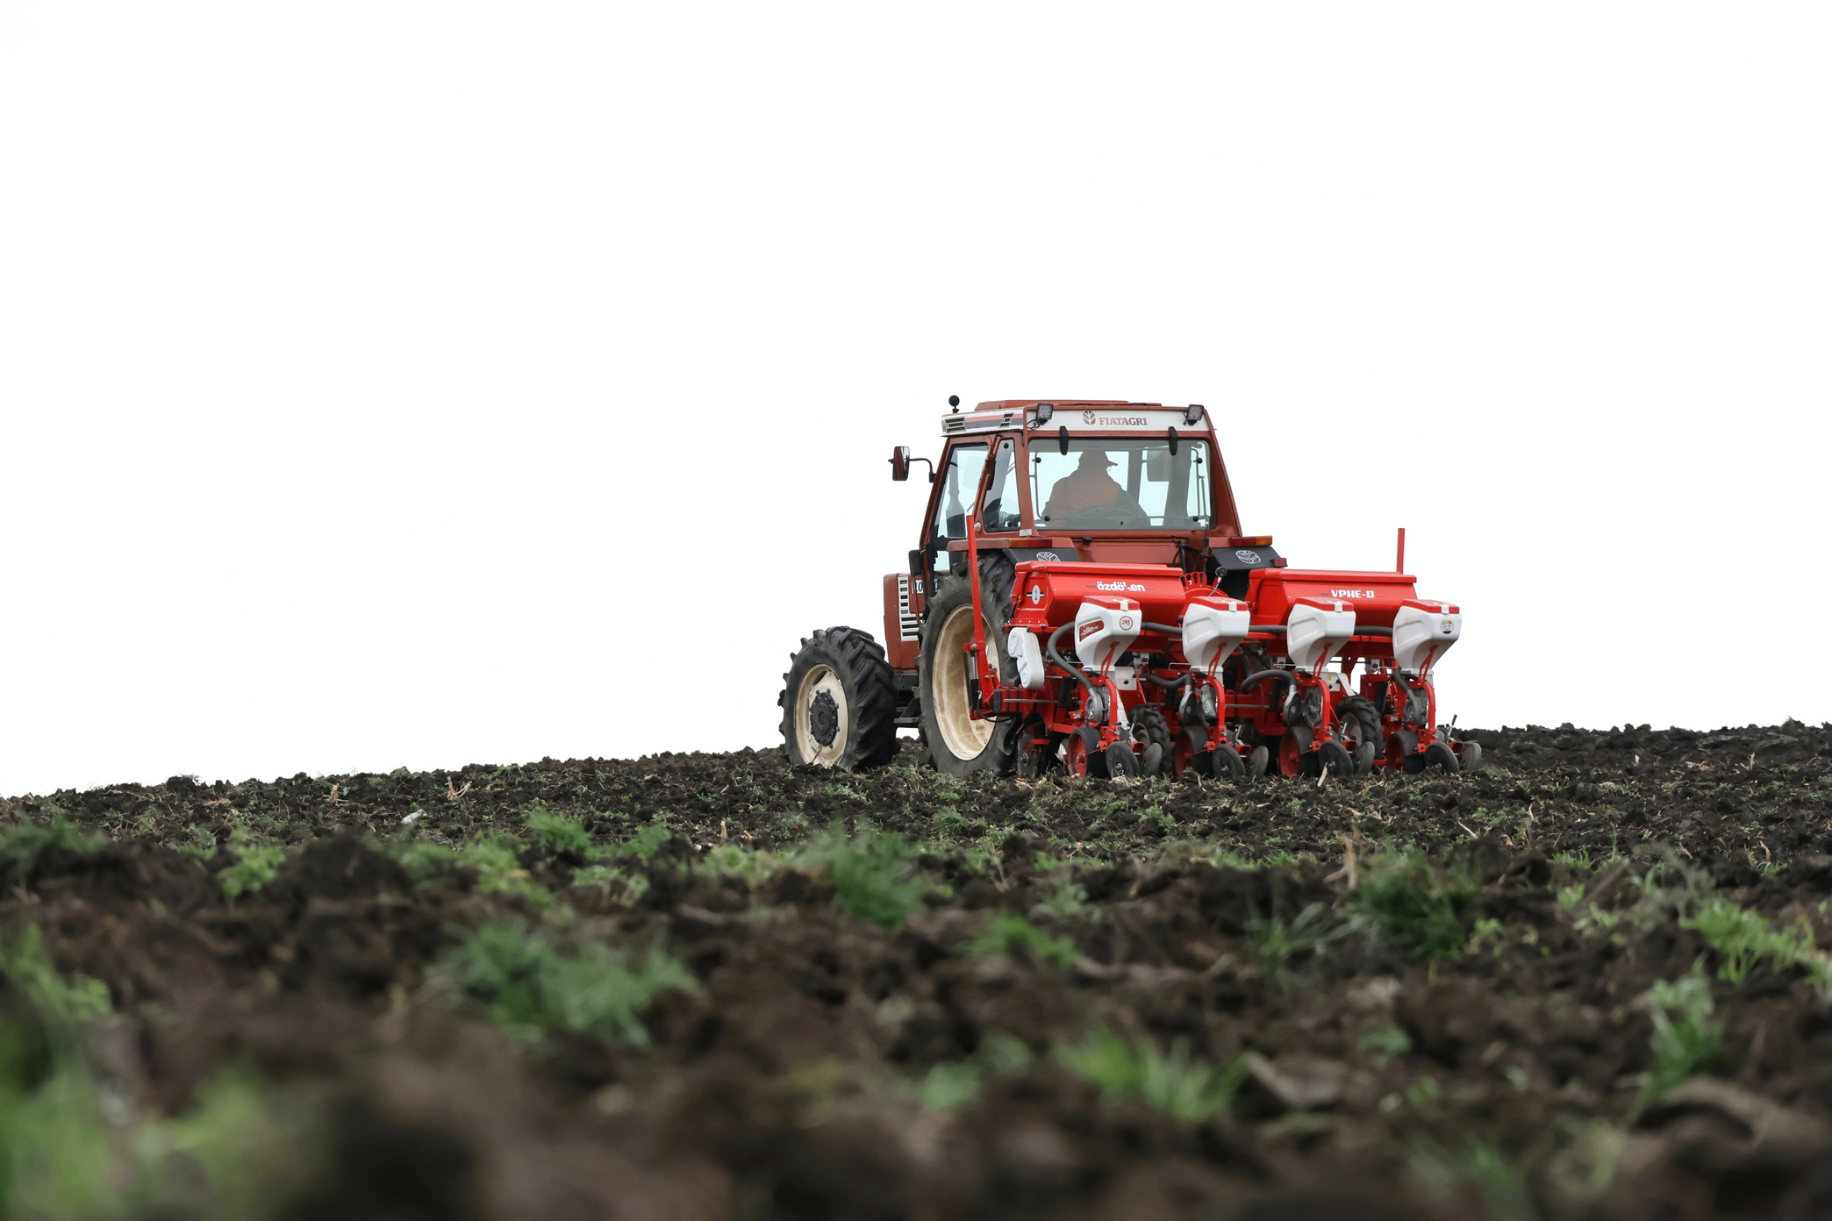
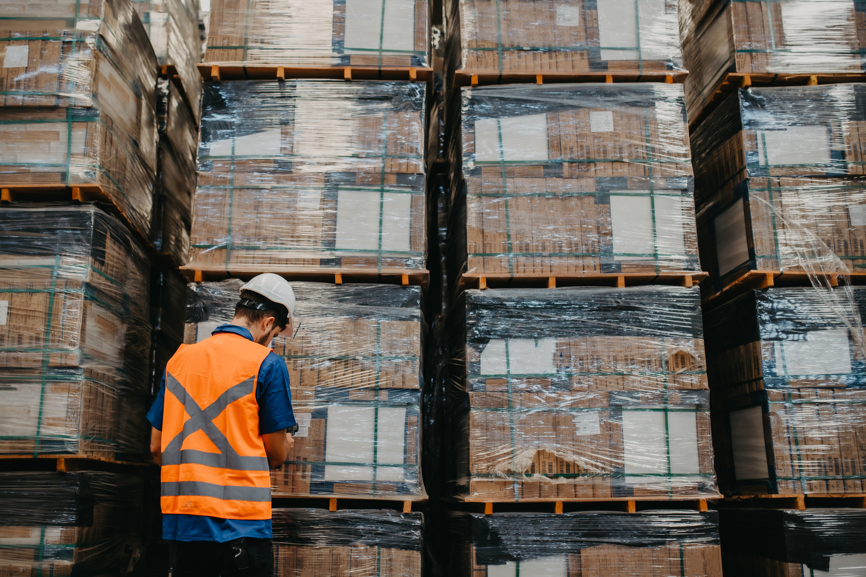
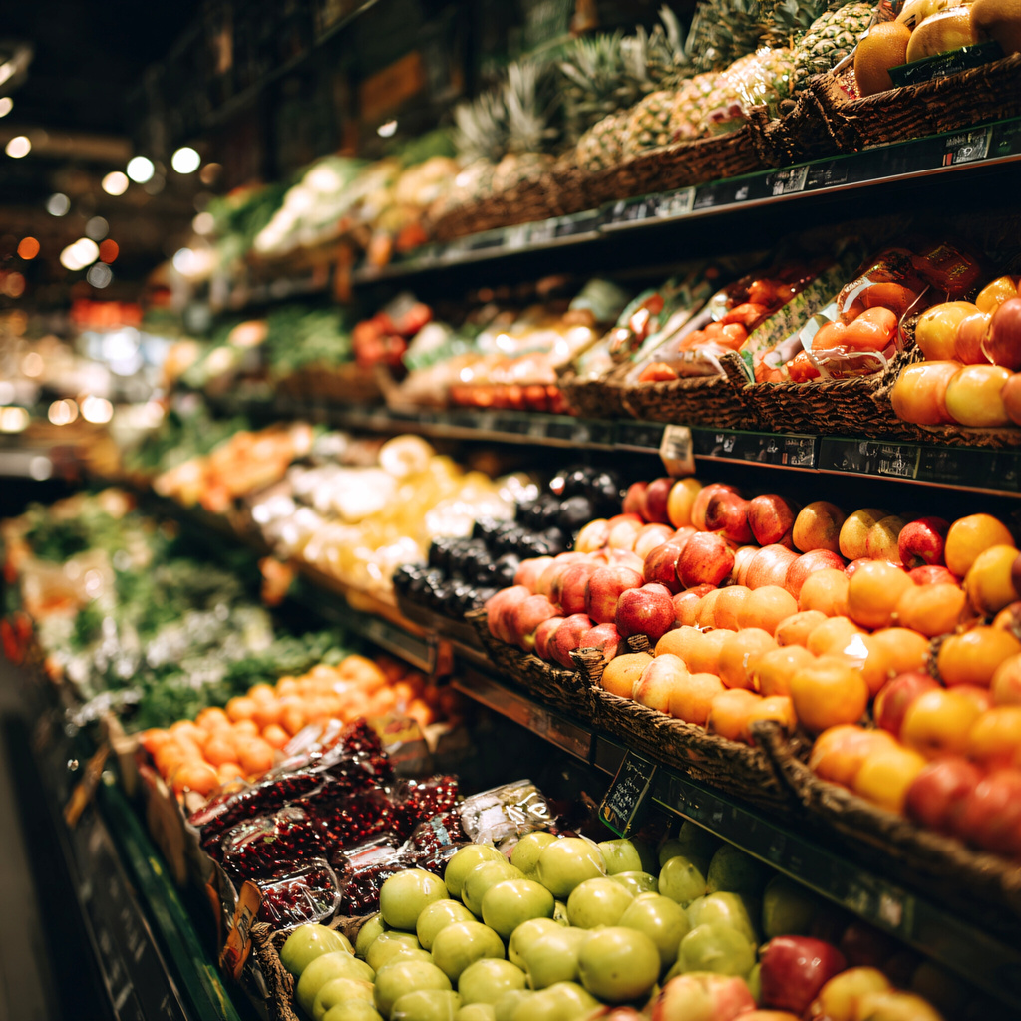
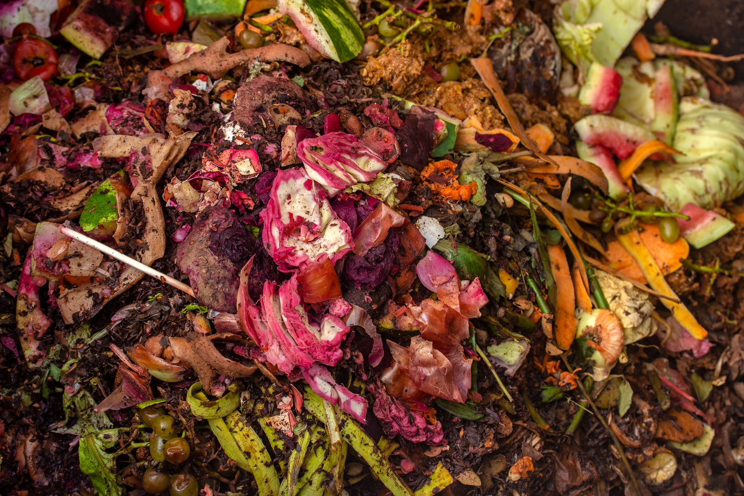
What is a Food System?
A Food System is a cycle of activities, impacts, and policies associated with producing, distributing, selling, consuming food, and disposing food including the individuals, businesses & organizations doing those activities (UF IFAS)
Notes:
- What is the food system def from UFIFAS
- Integral for the community to thrive/whom it impacts
- Nod to pillars but expand on it in the next slide

Slide 5


What is a Food Plan?
Food plans are strategies that identify how a city may address their community’s food related needs & offer opportunities for growth. It creates a plan to ensure affordable and accessible fresh food, supports locally owned farms & food businesses, outlines an emergency preparedness strategy, while also offering ways to efficiently handle food waste.
Notes:
- What is the food plan?
- Components of the plan?
- Why are we doing the plan?

Slide 6
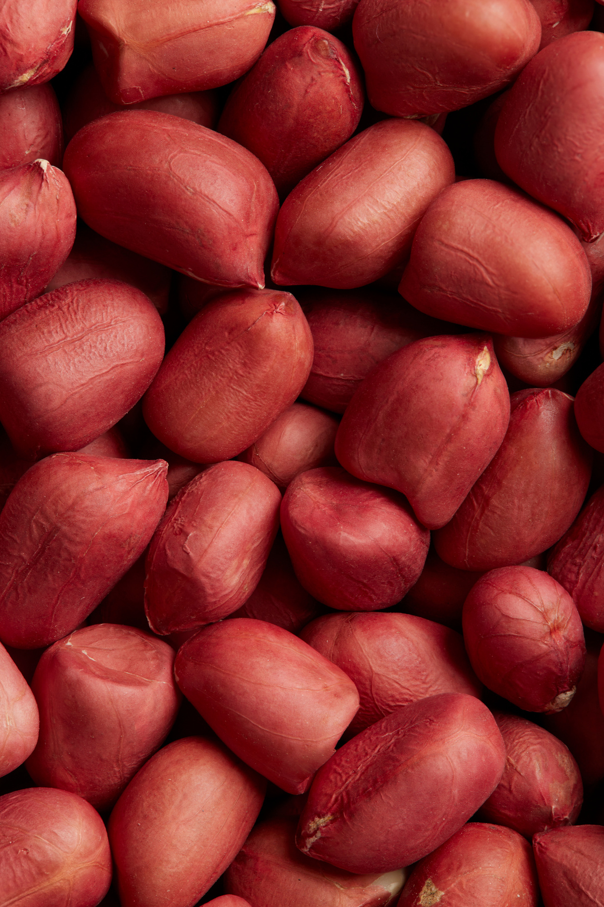
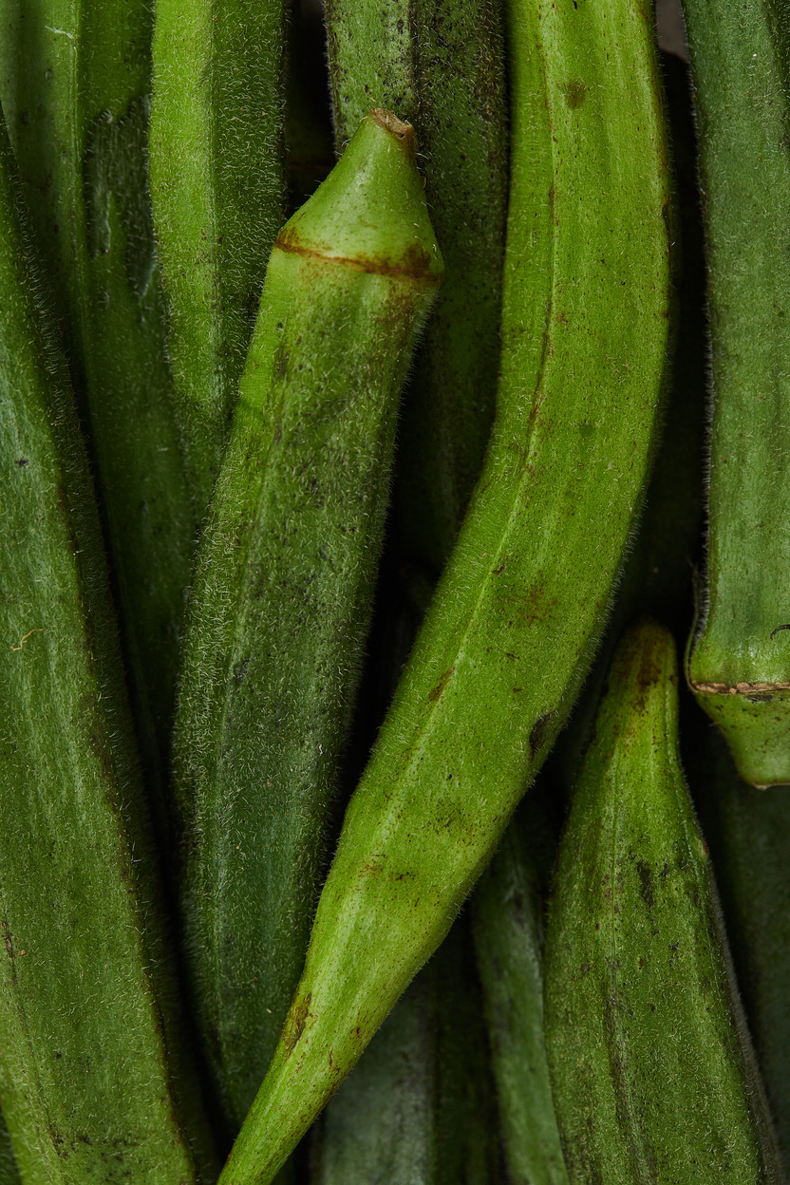

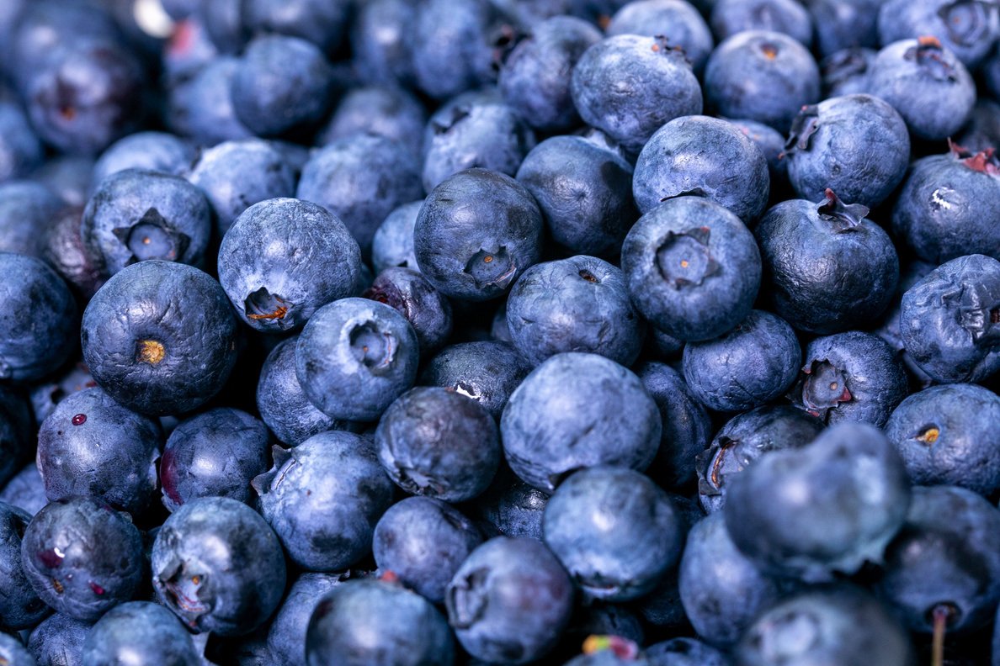
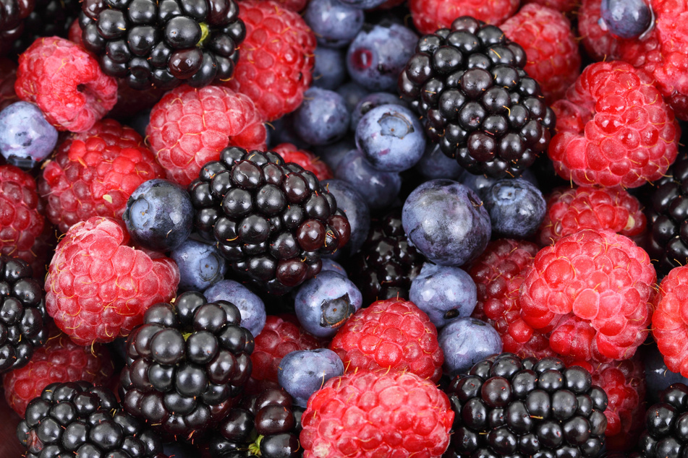
What’s in a Food Plan
Analysis of Pillars
A robust analysis of Jacksonville’s food system. The current state of our food production, distribution, access, and waste sectors. Analyzing their operations, economic value & policies that support or stifle progress & partnerships
It’s a snapshot of how food is being produced, moved around, eaten, and wasted within the city.
Identifying Gaps & Constraints
The analysis depicting the current state of our food system will highlight gaps and constraints within each pillar. (i.e. Local agencies are not steering the process of grocery store placement in food insecure areas )
Identifying Opportunities for Growth
Based on the analysis of all pillars, identifying gaps and constraints, and working alongside stakeholders. This plan will comprise of opportunities for growth within our food system. (i.e. circulate common language, incentivize local business partnerships, food policy proposals)
Notes:
- What is the food plan?
- Components of the plan?
- Why are we doing the plan?

Slide 7




Food System Pillars
Jacksonville’s 1st Food Report will Analyze these four pillars in our food system & how they interact with one another
Production
Processing & Distribution
Urban faming, regional agriculture & the resilience of those supply chains
Local food hubs, warehousing, logistics that move products efficiently throughout Jacksonville.
Waste
Diversion programs composting, food recovery networks, that reduce landfill impact &redirect surplus to those in need
Access
Availability of grocery stores, restaurants & emergency food providers, while also addressing affordability challenges and nutrition gaps.

Slide 8




Tools - How can COJ affect change
  Data
  Partnerships
  Standards & Practices
  Planning
  Tools that Shape Each Pillar
  Funding
  Education
These tools are within each pillar of our food system and can be used to create change
  Regulations
  Resource & Investment
Notes:
Knowledge & Strategy - Jenny Powerpoint on throughlines

Slide 9
Pillars
Jacksonville’s 1st Food Report will Analyze these four pillars in our food system
01
03
Food Production
Access
Urban faming, regional agriculture& the resilience of those supply chains
Availability of grocery stores, restaurants & emergency food providers, while also addressing affordability challenges and nutrition gaps
02
04
Processing & Distribution
Waste
Diversion programs composting, food recovery networks, that reduce landfill impact &redirect surplus to those in need
Local food hubs, warehousing, logistics that move products efficiently throughout Jacksonville
Notes:
- In notes, add how to talk about each pillar, what is considered in each?

Slide 10
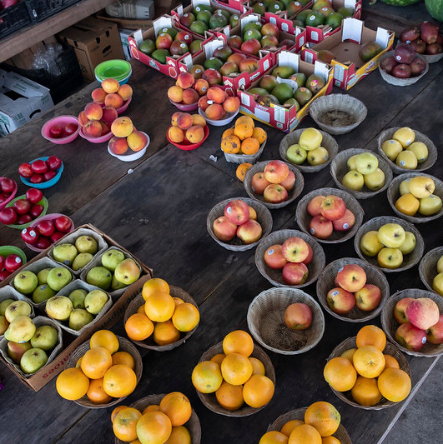
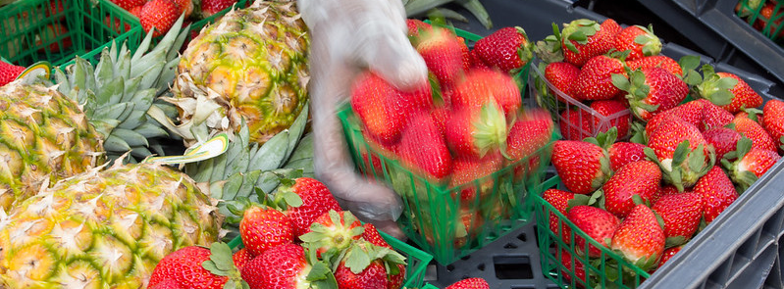



FOOD PRODUCTION
Urban farming, regional agriculture, fishing & the resilience of those supply chains.
20,000+ acres of land dedicated to agriculture
314 Farms
$6.8 million value of local farmers products
Notes:
- Two text boxes
* One blurb describing the pillar
* 3-5 statistics

Slide 11
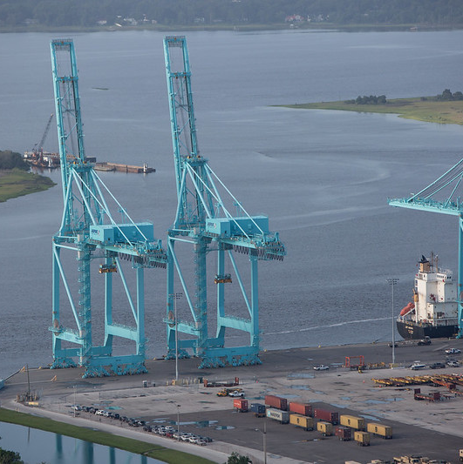
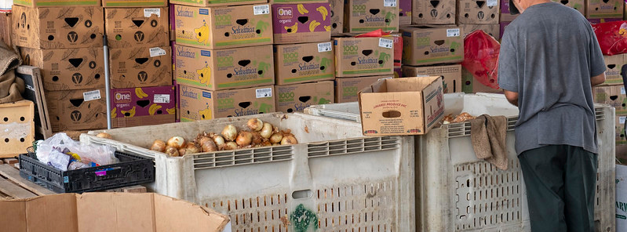


DISTRIBUTION
Local food hubs, warehousing, cold storage, and logistics that move food efficiently throughout Jacksonville.
171,500 residents are employed through our distribution sector
JaxPORT imports over 300,000 MTONS of food

Slide 12
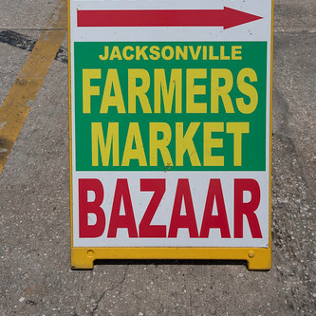
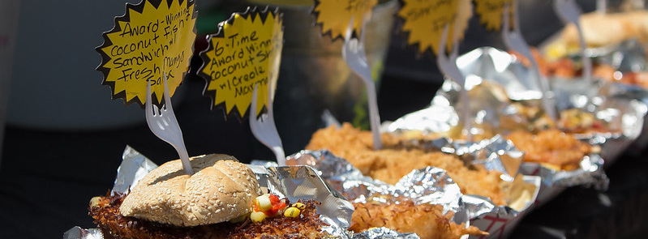


FOOD ACCESS
Availability of grocery stores, farmers’ markets, restaurants & emergency food providers, while also addressing affordability challenges and nutrition gaps.
1 out of 7 people in Duval County are food insecure
SNAP generates $69 million in economic activity

Slide 13
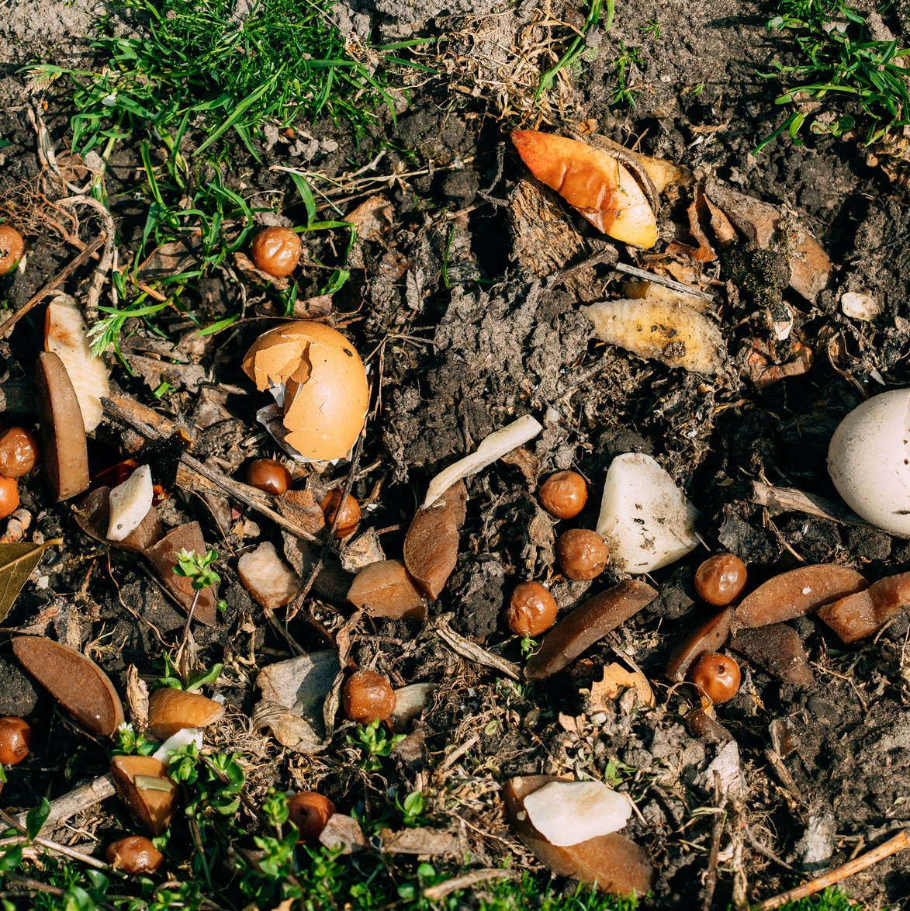
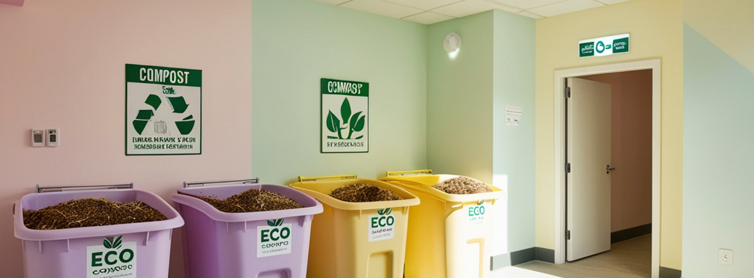

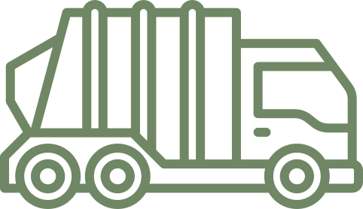
WASTE
Food diversion programs, composting, and food recovery networks that reduce landfill impact & redirect surplus to communities in need
On average Jacksonville residents produce roughly 552.5 million lbs of food waste annually
Food waste comprises of 24.1% of municipal solid waste

Slide 14
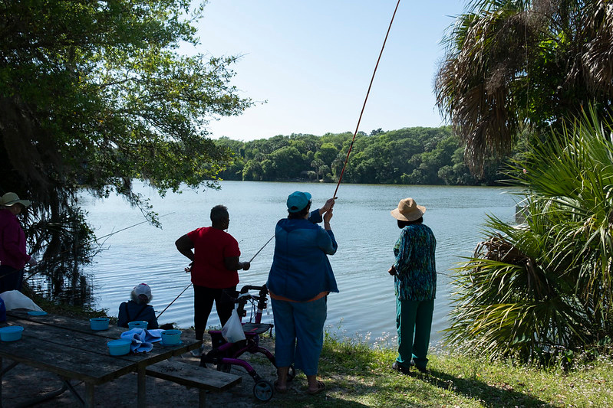
NEXT STEPS
COMMUNITY ENGAGEMENT
  Public meetings
  CPAC Meetings
  Survey & Targeted Outreach
PLAN DRAFTING
  Synthesize community feedback
  Integrate comments into the final plan
FINALIZE PLAN & PUBLISH
  Summer 2026
IMPLEMENTATION
  Strategize implementation priorities
  Carry out target strategies
Notes:
Working group meetings
CPAC Meetings
Community Public Meetings

Slide 15
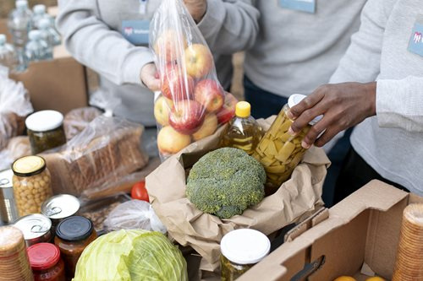
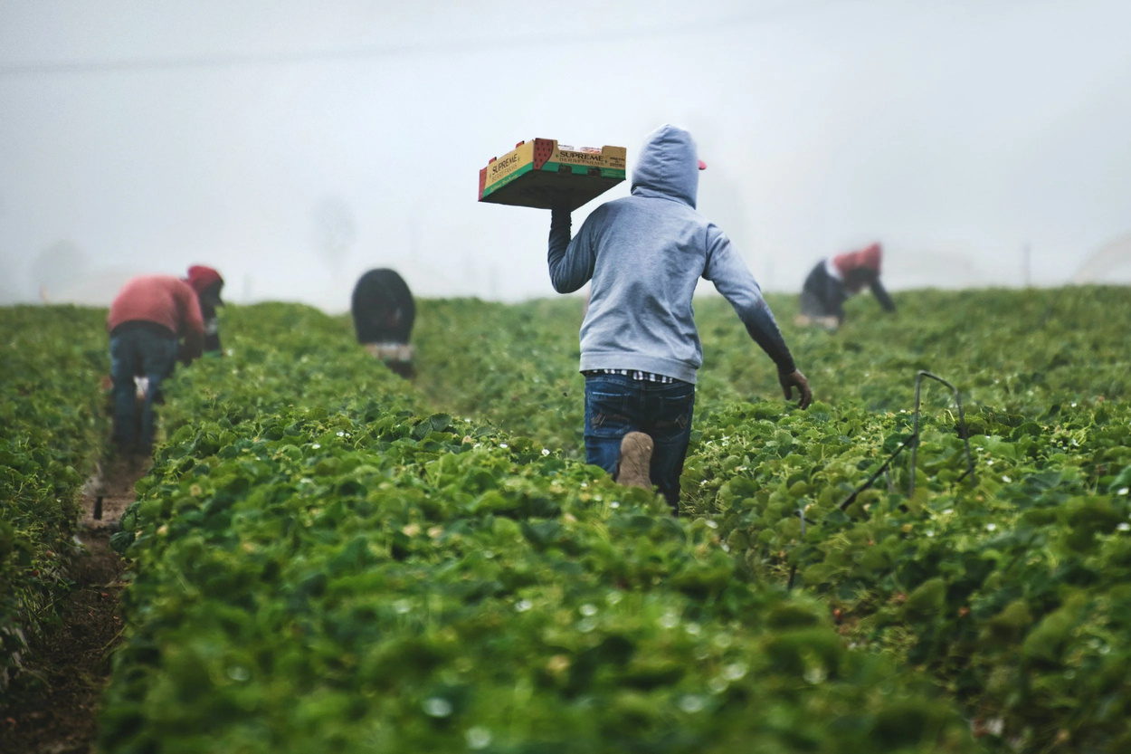
Current Resources
This plan touches on a range of challenges our city is navigating & addressing. Here are resources that are standing in the gap, ready to support Jacksonville’s residents today.
Duval Care Coalition
Network of faith-based organizations, nonprofits, and community food banks that ensure no resident in need goes without essential support.
https://www.jacksonville.gov/snap
NEFL Farmers Consortium
Network for regional growers to receive shared tools, knowledge, and infrastructure necessary to thrive.
https://www.neflfarmers.com/
Notes:
- What is the food system def from UFIFAS
- Integral for the community to thrive/whom it impacts
- Nod to pillars but expand on it in the next slide

Slide 16

Office of Resilience
THANK YOU
If you have any questions or insight you would like to share please email us
foodplan@coj.net

